Slide 1
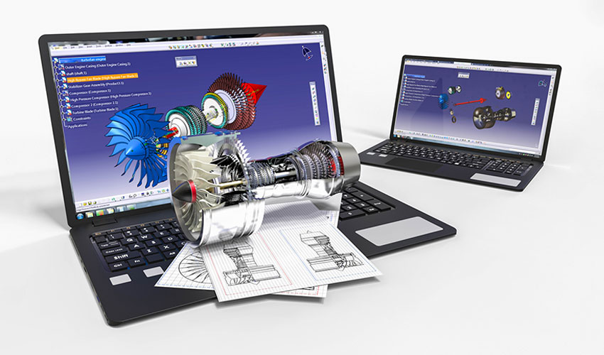
National 5 Design & Manufacture
Commercial Manufacturing

Slide 2
Learning intentions & success criteria
Learning Intentions
Learning about the influences of computers on Design and Manufacturing.
Success Criteria
Explain the impact of computers on design and manufacturing.
Understand and explain: CAD, CAM, Rapid prototyping and Global manufacture.

Slide 3
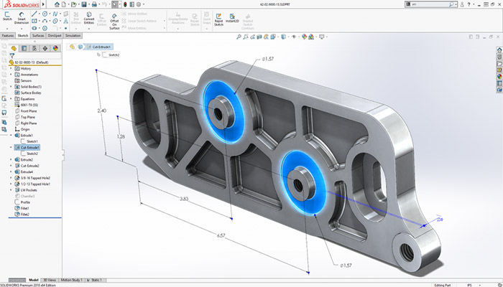
What is CAD
Computer Aided Design (CAD) is a system which allows the user to input design information.
Shapes
Forms
Materials
Sizes
Tolerances
Standard components can be stored in a library to save time.
Simulations can be performed to test behaviours, properties and to identify errors.

Slide 4
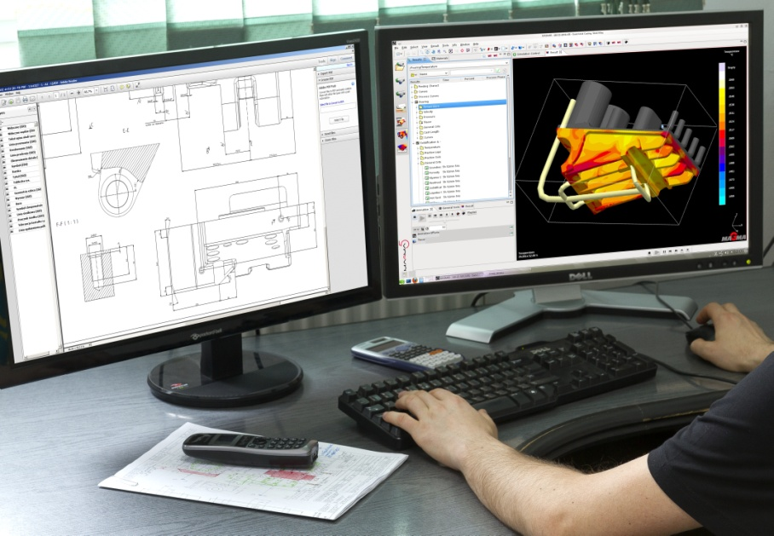
The rise of CAD
Almost all design work is carried out using CAD systems.
Whilst initial ideas may be sketched manually, CAD systems allow designs to be represented in 2D and 3D.
Even in schools, CAD systems are crucial in Craft, Design & Technology based subjects.

Slide 5
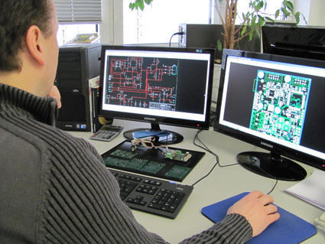
Advantages of CAD
Development time is reduced drastically.
Quality and accuracy of design work is increased.
Improvements are easily identified and quickly implemented.
Data is easily stored, retrieved and shared.
Design work is better integrated in to manufacturing systems.

Slide 6
Disadvantages of Cad
Initial setup costs are high and software is expensive.
Software must be updated regularly.
Staff require training which is costly.
Difficult to manage intellectual property rights when information is stored centrally.

Slide 7
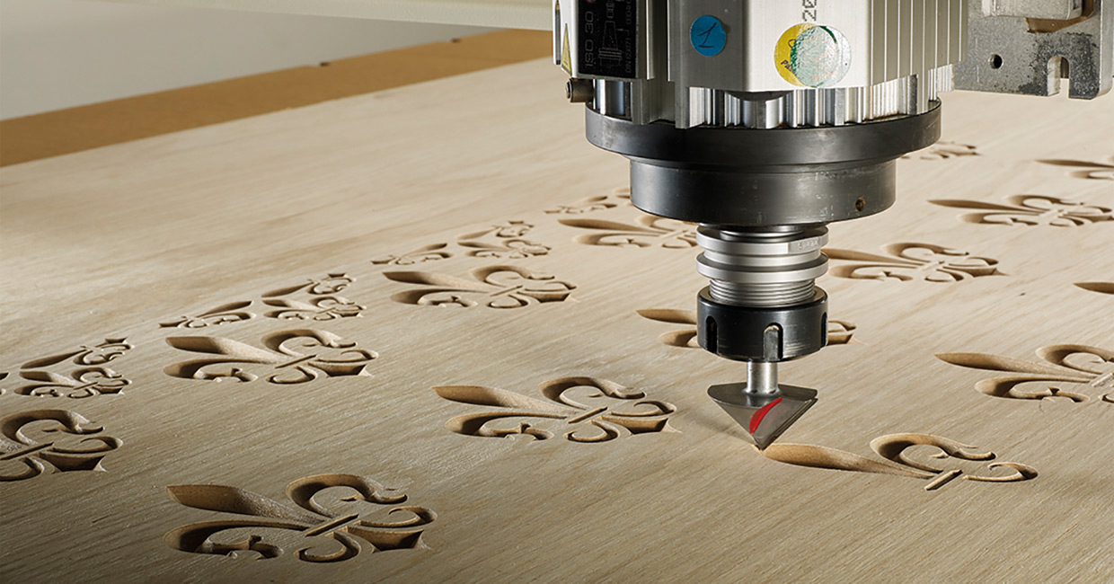
What is cam?
Computer Aided Manufacture or CAM is a manufacturing system where machinery and equipment is controlled by computer.
The use of computers in manufacturing with Computer Numerical Control (CNC) systems in the 1960s.
CNC systems used complex numerical commands to manage machinery and tooling.
However, the setup cost was very high.
CNC video-
https://www.youtube.com/watch?v=lEyNWtM6MW4

Slide 8
Evolution of cam
Now it is possible for even the smallest manufacturers to use CAM systems.
High powered computers are widely available at affordable prices and electronic/cloud storage means instructions/commands can be programmed quicker.
Designs and modifications can be implemented more quickly and the design process is more responsive to consumer needs.

Slide 9
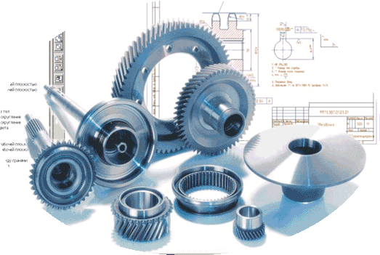
Evolution of cam
Machine Program Input
CAD System
Computer (Controller)
Machine Tool(s)
The computer has the ability to accept information from different sources to control more than one tool at once.
Detailed working drawing(s)
Production Output

Slide 10
Advantages of cam
The reliability of CAM systems result in higher productivity and therefore lower costs.
Eliminates and limits human error.
Programs can be easily updated and modified.
Complex operations can be carried out easily.
Once programs are operational, highly skilled operators are no longer required.

Slide 11
Disadvantages of cam
Installation and start-up costs can be high.
Skilled technicians are required for maintenance, resulting in high training costs.

Slide 12
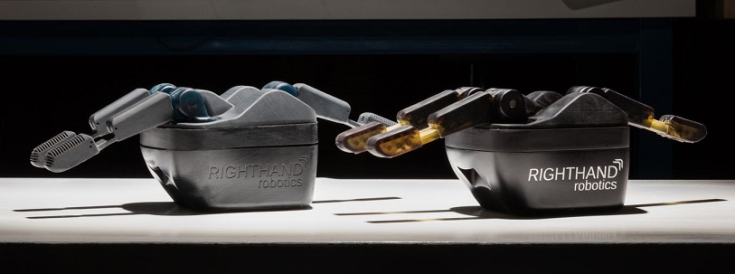
Rapid Prototyping
Rapid prototyping is a CAD/CAM process that generates a 3D model instantly from a Computer aided drawing.
Advantages include-
Reasonably fast to produce a prototype.
The prototype can be made from the actual material the product is made from.
The level of accuracy is extremely high.
Moving parts can be created (Unlike models).
Models can be adapted and reproduced quickly.
The client can see the product as a high quality prototype.

Slide 13
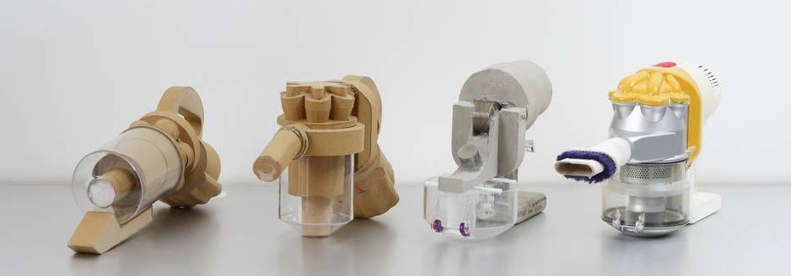
Rapid Prototyping
Disadvantages include-
Added initial costs.
Some rapid prototyping processes are still expensive and not economical.
Requires skilled labour.
Overlooking key features that can not be prototyped.
End user confusion, customers mistaking it for the finished product.

Slide 14
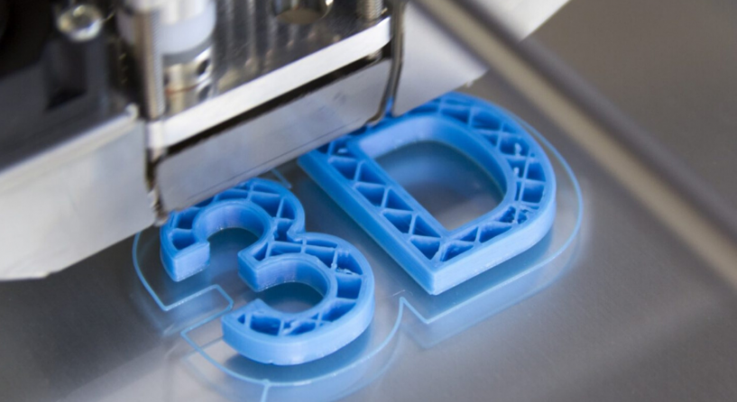
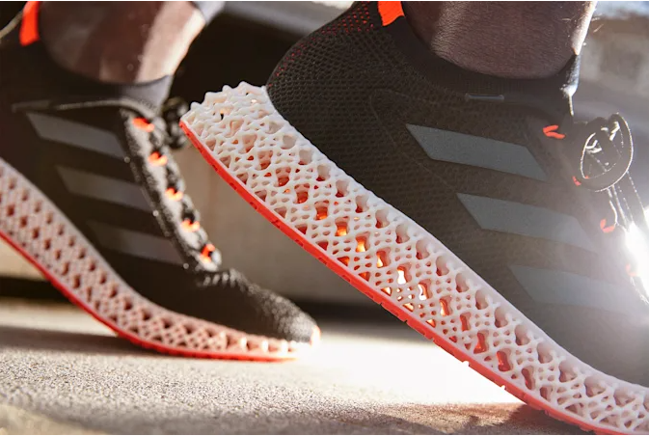
3d printing
3D printing is becoming more affordable and popular as a manufacturing technique.
Advantages include-
Flexible designs
Rapid prototyping
Print on demand
Strong and lightweight parts
Minimises waste
Cost effective
Ease of access
Environmentally friendly (reduces material waste/recyclable waste)

Slide 15
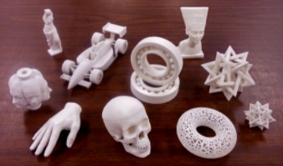
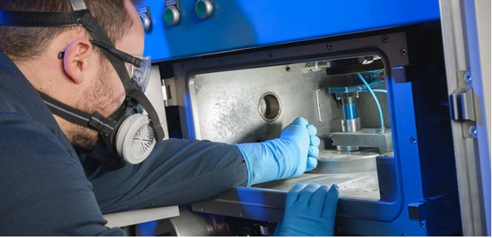
3d printing
Disadvantages include-
Limited materials can be used
Restricted build size
Large volumes are not as cost effective
Design inaccuracies
Copy right issues

Slide 16
One off production
The way products are manufactured depends on the quantity required. For example, cars are continually manufactured in hundreds of thousands , a prototype is a ‘one off’ (just one made) and DIY furniture is made in batches of thousands. Single item production is described below.
A highly specialised company.
Small highly skilled workforce, possibly one or two workers, sometimes more.
Constant communication with the client, constant discussion regarding the design.
Company specialises in particular areas such as engineering or musical instruments etc...
Specialist materials are often required eg. specialist woods or modelling materials6. The final product is expensive due to
the level of skill needed to manufacture the product and the cost of specialist materials and equipment.
A high standard of quality control
Products are manufactured for a specialist market / clientele
eg. musicians, medical profession, aerospace.

Slide 17
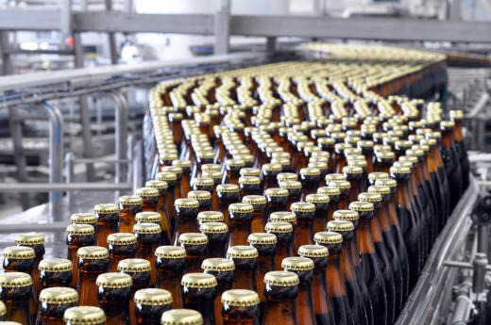
Mass production
Mass production is the production of large quantities of a standardized products by an automated mechanical processes.
The benefits to the manufacturer can include:
Speed of production of products
Economies of scale / cheaper to produce a large number, making each single product cheaper
All the products are produced accurately and to a high standard
Quality of finish is excellent on all products
All the products are exactly the same
There is no need to pay a large workforce, therefore reducing labour costs

Slide 18
Mass production
Mass production can also affect society i.e. people and villages/towns/cities in many ways:
products are cheaper so more accessible to buy
a larger range of products available
products are more readily available/meets consumer demand
quality assurance
reduction in jobs
economic decline of area
skilled workers required for higher level roles
less labour intensive jobs
some workers becoming deskilled
loss of manufacturing knowledge in industry
reduction in work related injuries.

Slide 19
Mass production
However, some products are not suitable for mass production and instead require one-off production:
The reasons can include:
The product requires skilled craftsmen
The product requires specialist equipment
The design is bespoke or one of a kind
A low volume of product is needed.

Slide 20
Global Manufacture
Over the past century there has been a rise in consumerism due to increased global population and the introduction of available products.
This has introduced highly automated machinery and a reduction in staff numbers/a skilled workforce.
Social impact-
Job availability for skilled workers.
Unstable jobs.
Some workers becoming deskilled.
Increased unemployment.
The closure of factories.
The decline of industrial towns and villages.
Economic decline of whole geographical areas.
Less labour intensive jobs.
Reduction in work related injuries.

Slide 21
Global Manufacture
Supply of products-
Products are cheaper.
Are larger range of products are available.
Products are more readily available/meet consumer demand.
Quality of product.
Throwaway culture.

